Slide 1
What MDA do
We MEASURE aircraft noise levels
  At 3 permanent noise monitoring terminals (NMTs) and
  5 temporary NMTs
  We use this to check District Plan compliance
  We use this to check our calculated contours
We CALCULATE compliance noise contours
  Using actual aircraft movement numbers, and runway use
  These are the primary tool to show compliance
We CALCULATE noise mitigation programme noise contours
  Using the compliance noise contours (above)
  AIAL provide growth projections for us to use

Slide 2
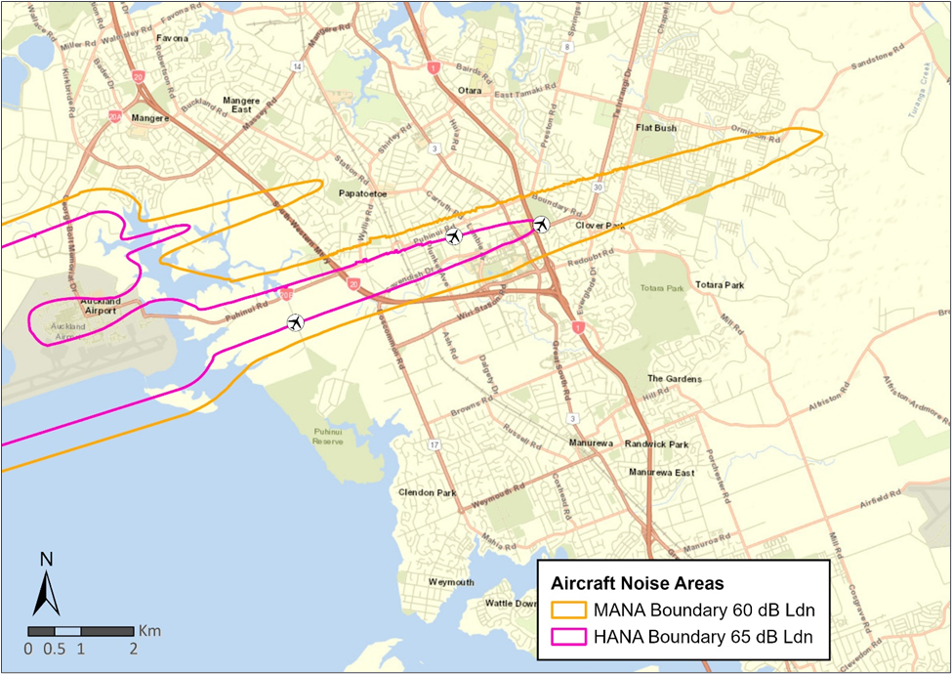
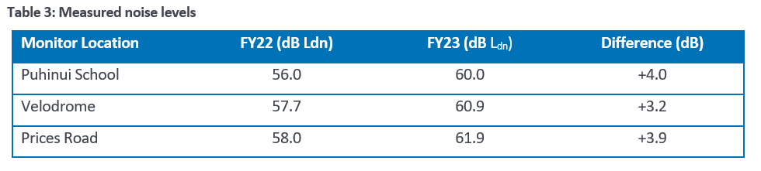
Measurements
Velodrome
Puhinui
Prices Road
Notes:
Section 4: Measured Noise Levels
Table 3 shows an average of the noise measured over the last 365 days at each monitor
Measured noise levels have increased by 3-4 dB from FY22
Used to check AUP compliance

Slide 3
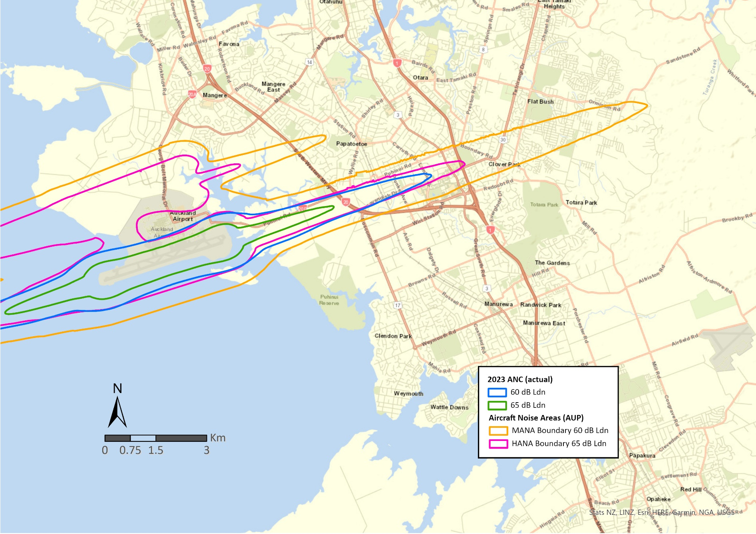
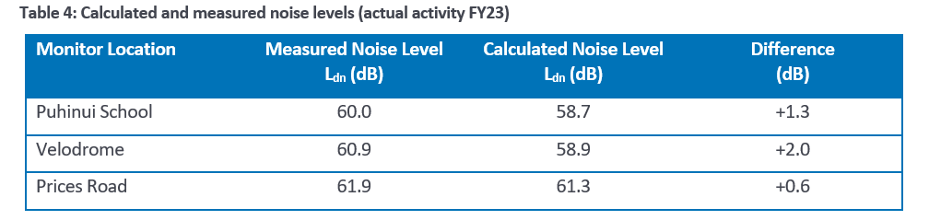

Measured versus Calculated
Table 4 is a comparison of the measured noise levels (from Table 3) compared to the noise levels calculated in the model.
  This is to verify modelling accuracy
Notes:
Section 5: Actual Noise Contour
Calculated from a model of the airport, using:
All aircraft movements from the last year
These are averaged over 365 days to get an “representative average day”
Therefore represents the average FY23 runway split (which favoured runway 05)
This contour is used to check AUP compliance

Slide 4
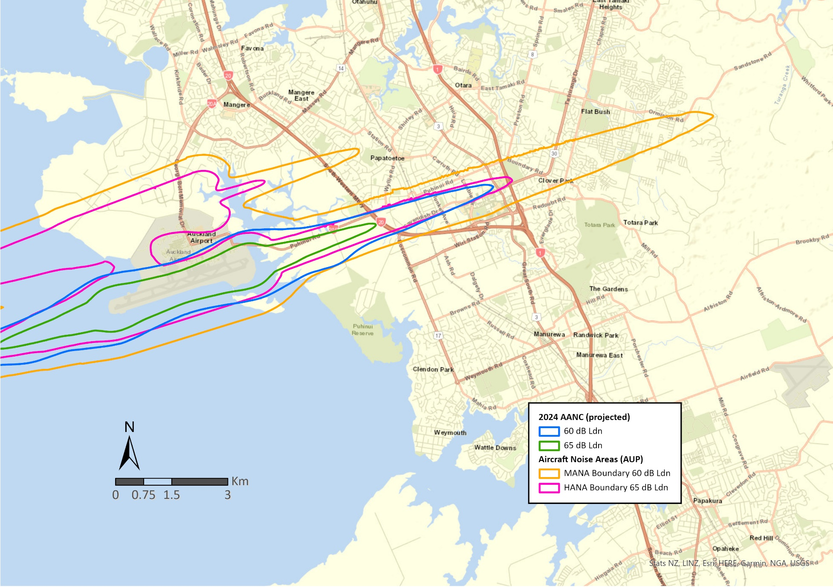
Projected Activity
Calculated using FY23 movements but with an AIAL predicted growth factor (20%)
It has the same runway split as ANC (favouring runway 05)
This contour is used for the Noise Mitigation Programme

